Slide 1
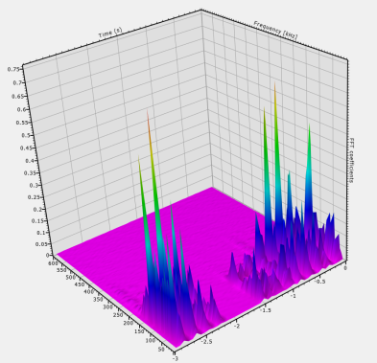
AE - Detection of fault conditions at the earliest opportunity
Structure Borne Sound
Horst Trattnig
Vallen Systeme GmbH
Schäftlarner Weg 26a
82057 Icking, München
Mobile: +49 163 66 25 648
Email: horst.trattnig@vallen.de

Slide 2
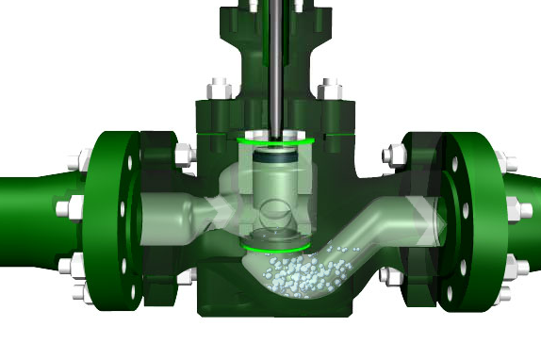
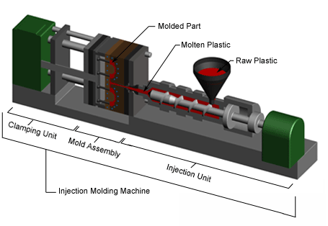
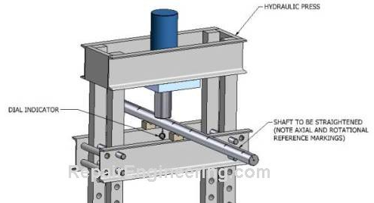
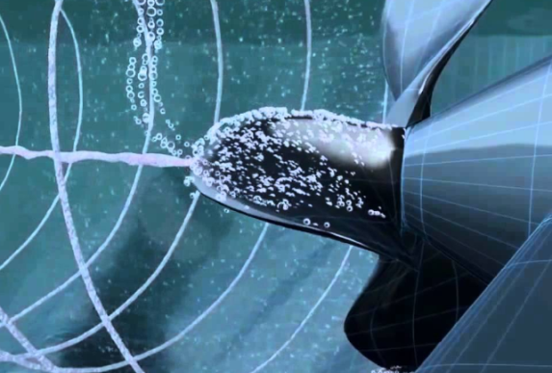
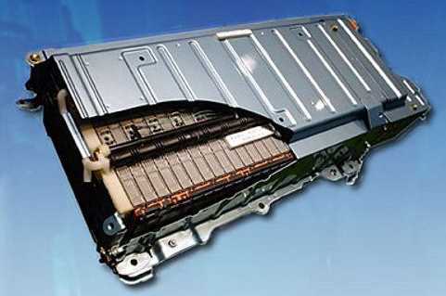
Markets – Process Monitoring and Early Aging Detection
Bearings and Rotating Machines
Valves and Pumps
Injection Molding Machines
Automatic Shaft Straightening
Cavitation Detection
Battery and H2

Slide 3
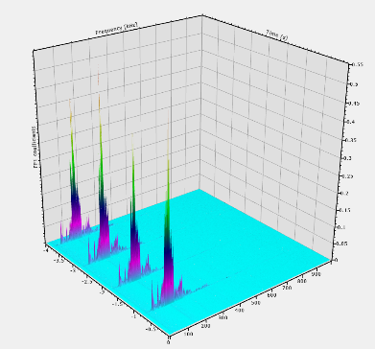
2 AE-Channel Edge Device (available 07.2019)
Passive AE
Sensors
1002 : 10 MSPS / 2 Channels
Application Software
Vallen Sensors:
> VS160-NS
> VS150-M
> VS150-L
…
Core DSP: Intel SoC
OS: Linux
Interfaces: Ethernet / TCP/IP / OPC UA / MODBUS TCP
Power : ~6 Watt / PoE
Dimensions: 140x34x114 mm
IP: 65
Data Pressing:
Input Range: +-50 mV
Bandwidth: 10 kHz – 1000 kHz
ADC: 16 Bit / 10 MSPS
Digital Filter: IIR BiQuad Technology
AE-Hit data: yes / up to 200.000 Hits/sec
28V Power: yes
FFT: yes
ML: yes
Output Parameters:
AE-Hits : yes
Continuous: FFT, APK, ASL, RMS
Wave forms: yes
Software:
Vallen SW (VisualAE)
LabView
Custom Software
Application:
Shaft straightening
Cavitation
Injection molding
Crimping
Machine monitoring

Slide 4
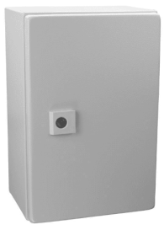
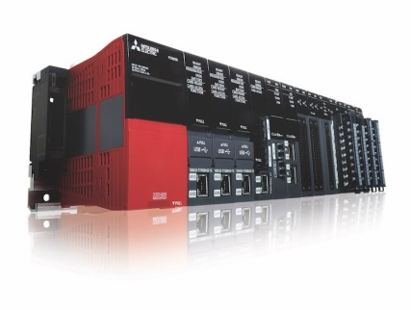
2 AE-Channel Edge Device – Data Flow
Data Acquisition
Data Processing
DIO Interface
Machine Control
and optional
Visualisation
Rack / Cabinet
Line PLC
IPC:
Application Program (LabView/Custom)
Decision:
Simple Go/NoGo output that can be feed into the line PLC.
No: GUI, Keyboard,
DIO 24 V
Alarm
Status
Interfaces:
2x LAN (1x PoE)
1x CAN
4x DIO (24V I/O)
HDMI; USB; WiFi; LTE
etc.
Setup and Maintain

Slide 5
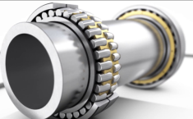
Condition Monitoring - Business Model
1. Production Company
Needs predictive maintenance for his machine shop
Application / Machine owner
Specification of requirements
success
3. AE Measurement Equipment Provider
2. Z-Check
Delivers AE Sensor
Support at test installation
Equipment expert
Customized solutions
…
Customer Relation
Application specialist
System integrator – SW adaption
Project management
Data analysis and reporting

Slide 6
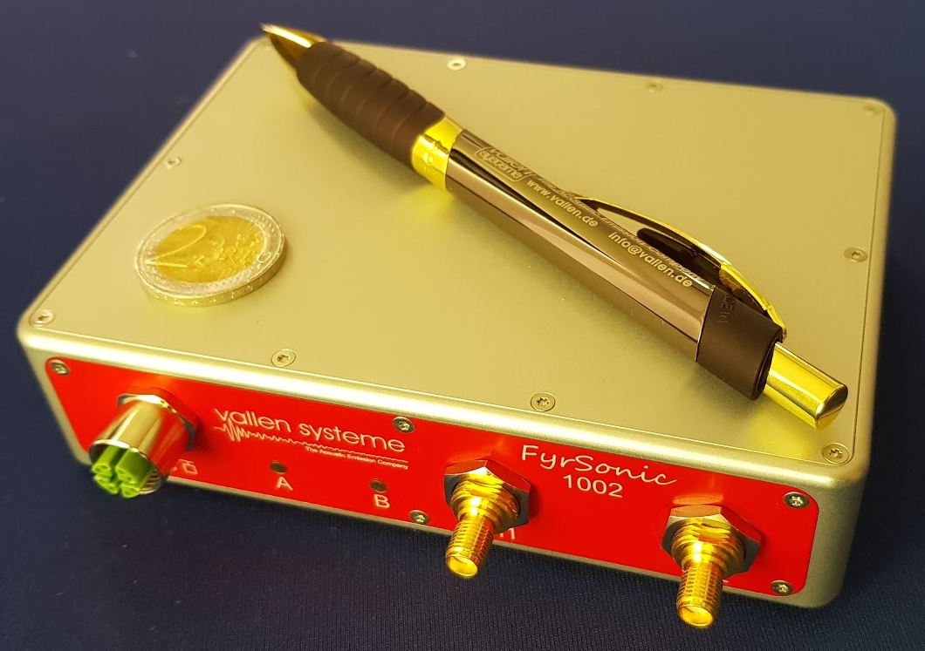
Picture of the 2 Channel Unit

